Slide 1
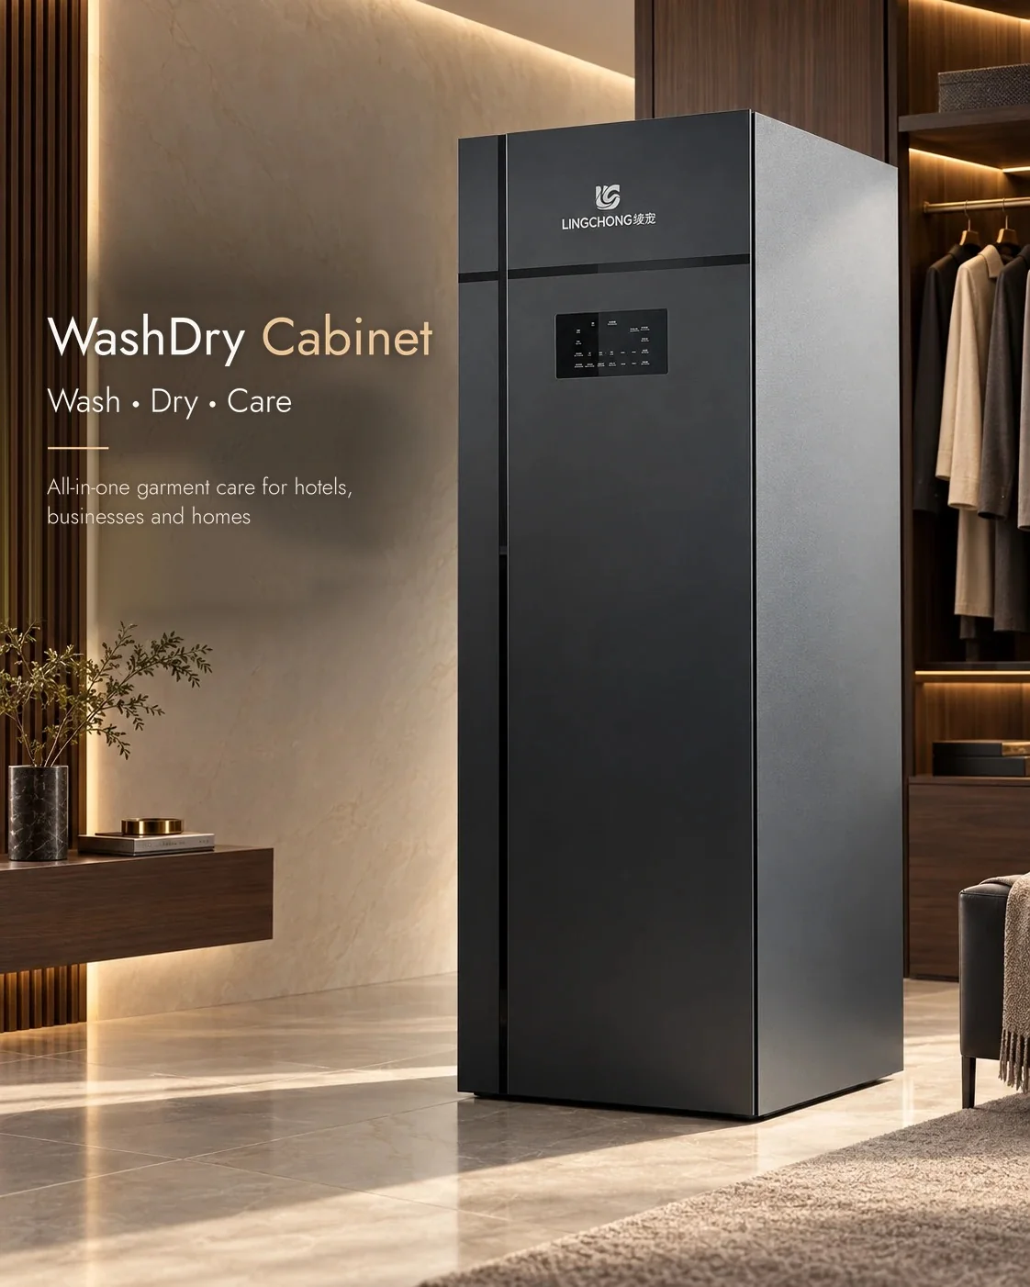
LINGCHONG
WashDry Cabinet
Distributor Brief & FAQ
Wash, dry and care in one cabinet.
Hanging spray washing with automatic drying and garment care.
Foshan Honghu Technology Co., Ltd. · gdlingchong.com

Slide 2
01 · ABOUT US
Furniture experience, dedicated product development
Foshan Honghu Technology Co., Ltd. was established in 2024 for this product. Our predecessor, Guangdong Suoaoer Smart Furniture Co., Ltd., has over ten years of experience in furniture and drying cabinets.
We developed the LC-308 over four years, with dozens of iterations before the commercial version. Our factory occupies 3,000 sqm in Foshan, Guangdong.
AT A GLANCE
10+ yrs
50,000
Furniture & cabinet manufacturing
All furniture units
Annual capacity
3,000 sqm
4 years
Foshan factory floor
LC-308 development
We hold invention and utility model patents for garment-care technology.

Slide 3
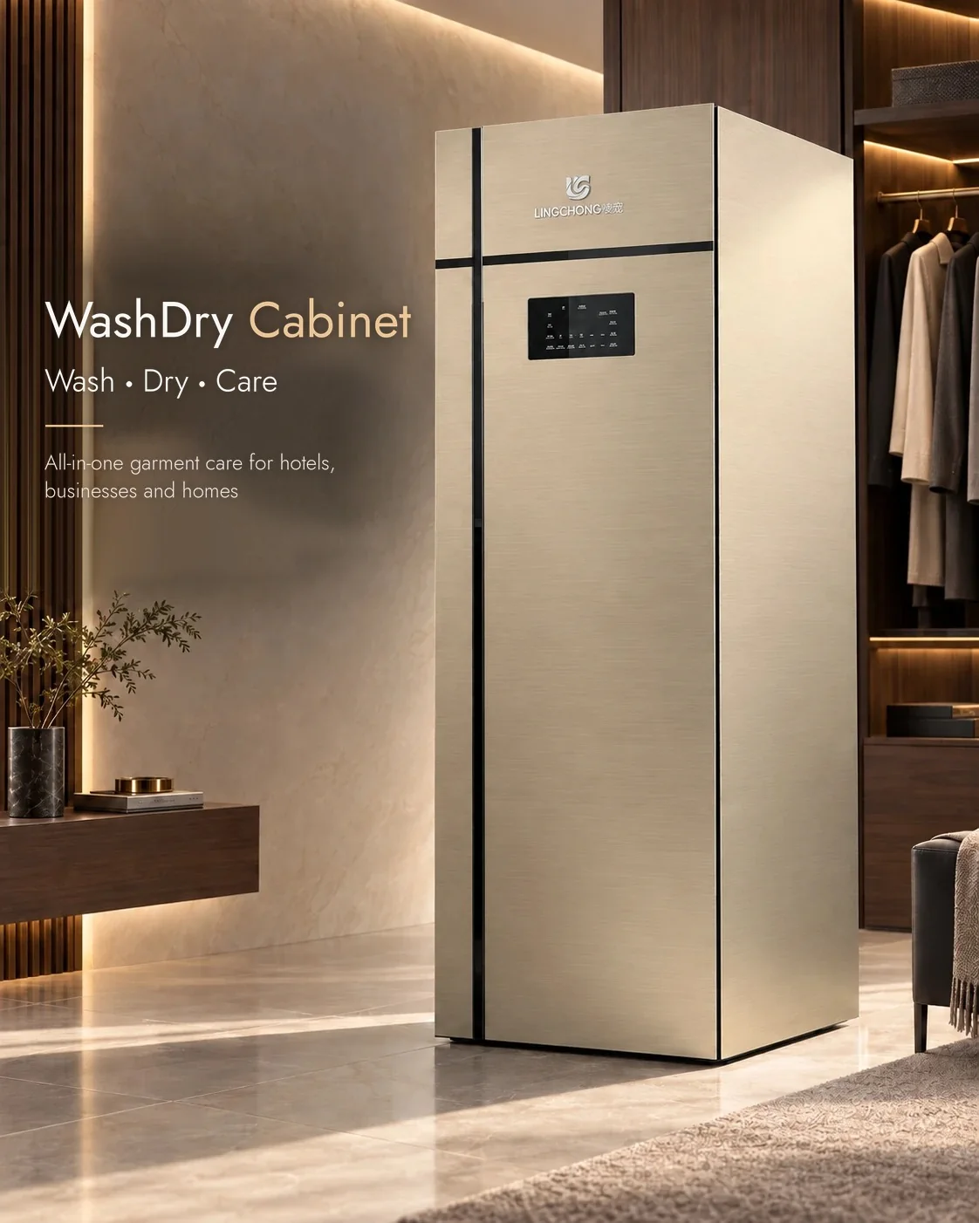
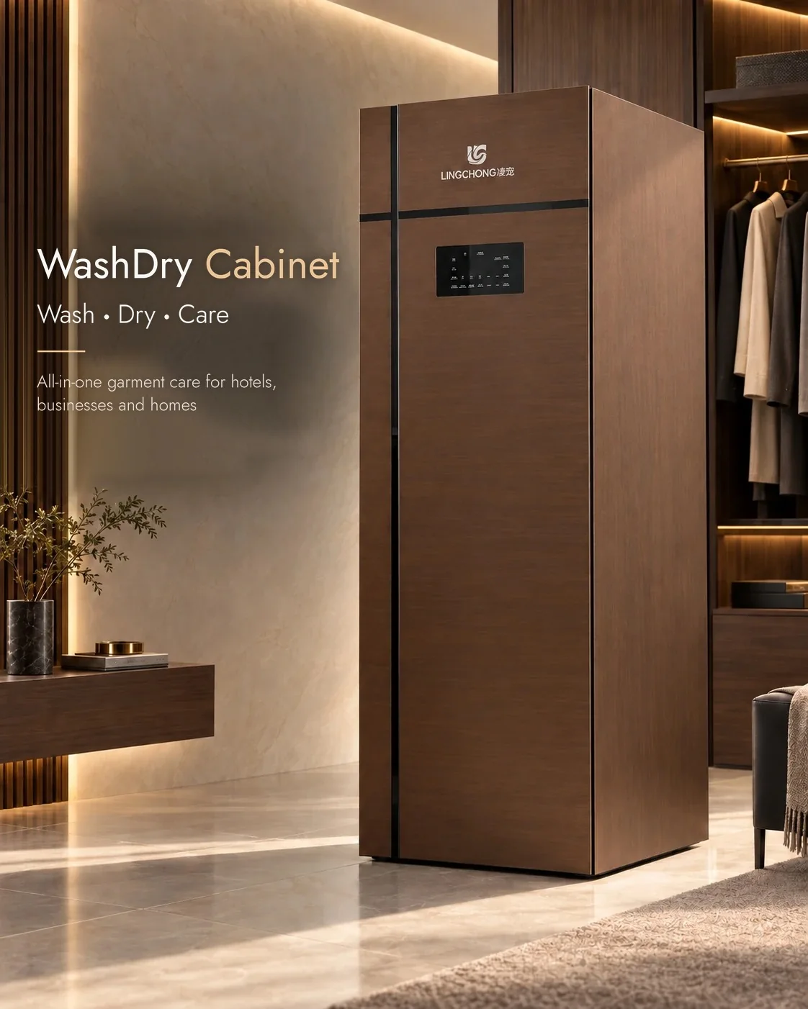
02 · PRODUCT LINEUP
LC-308 and custom configurations
Standard model: LC-308 (single-door)
Custom options for your market
The LC-308 single-door cabinet washes, dries and cares for 8 lightweight garments or 4 thick garments per cycle. Standard finishes include black, champagne and walnut.
Double-door format for custom orders
Custom size, color and appearance
110 V or 220 V by order
Plug configured for the destination country
OEM logo, packaging and UI language
Tell us your required size, finish and installation conditions. We confirm the configuration with your order.
Champagne
Walnut

Slide 4
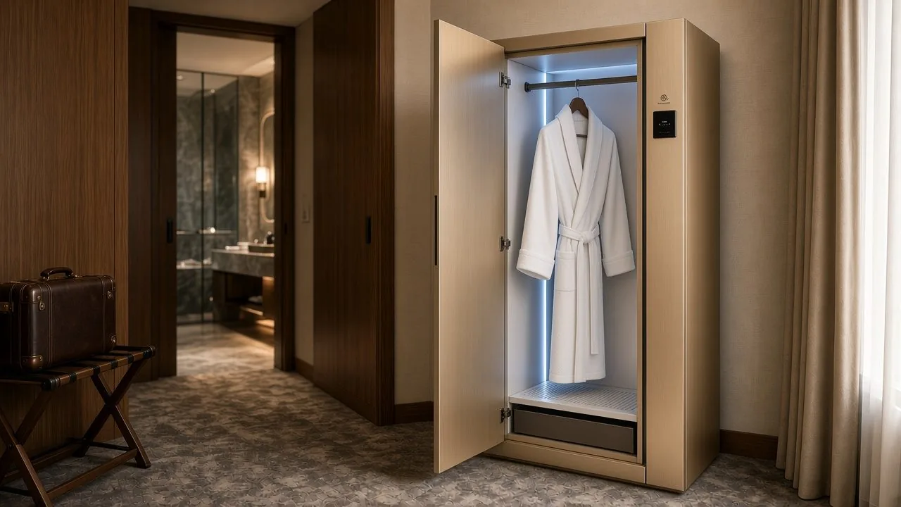
03 · HOW IT WORKS
Wash, dry and care in one cabinet
01
Hanging spray wash
Garments stay on hangers during spray washing. The cabinet automatically dispenses and dilutes the detergent.
02
Smart drying with auto-stop
Built-in temperature and humidity sensors stop drying automatically when garments are dry. Timed drying options: 60, 120, 150 or 180 minutes.
In-room installation for hotels and suites
03
Ready to wear
Hanging wash and drying reduce creases and ironing needs. An aroma box adds a fresh scent. A typical full cycle takes 2-3 hours.

Slide 5
04 · SPECIFICATIONS
LC-308 technical specifications
Dimension / Weight | Electrical / Water | Performance
Product size (H x W x D) | Voltage (order config) | Wash method
190 x 60 x 62 cm | 110 V or 220 V | Hanging spray, no tumbling
Package size (H x W x D) | Rated power | Capacity per load
208 x 68 x 71 cm | 1600 W | 8 light / 4 thick garments
Net / Gross weight | Water / electricity | Typical cycle
80 kg / 96 kg | 60 L per wash Approx. 3.5 kWh per cycle | 2-3 hours
Body: fluorocarbon aluminum composite panel (5 layers), aluminum-alloy wrapped, flame-retardant. Custom colors available.

Slide 6
05 · MAINTENANCE
Maintenance and detergent
Routine care
Dedicated detergent
Self-cleaning filter inside the water valve
Plant-based, no-rinse detergent
The cabinet automatically dispenses and dilutes the liquid.
Integrated chamber with an Auto Clean program
No dismantling or washing of the filter
About 50 mL per cycle. Refill up to 0.75 L.
Wipe the chamber surface during daily care
A 1.5 L bottle provides about 30 washes.
No scheduled maintenance for internal parts.
A 0.75 L refill covers about 15 washes. Standard replacement parts are available when a fault occurs.

Slide 7
06 · WARRANTY & SUPPORT
Three-year warranty and local service
3 years
Local service, factory support
1. Your team diagnoses and reports the fault.
All components are covered for three years from factory dispatch, excluding damage caused by misuse or other human actions.
2. We confirm the fault and supply replacement parts.
3. Your team handles local repairs. We train your technicians.
Within warranty
After warranty
Whole-unit replacement
Free replacement parts and air freight. Parts reach your service team within one week after fault confirmation.
Parts at factory cost. Your company sets local delivery and repair charges.
If we confirm a factory quality issue, we replace the cabinet and pay the replacement freight.

Slide 8
07 · QUOTATIONS
Order quotations
Sample and volume inquiries
SAMPLE AND BULK ORDERS
Order quantity | Quotation | Notes
Sample / 1-2 units | On request | Test unit
10+ units | On request | MOQ
100+ units | On request | Distributor
1,000+ units | On request | OEM / project
Contact us
gdlingchong@gmail.com
WhatsApp: +86 185 7398 9700
Quotes depend on order quantity and configuration. EXW Foshan. Sea freight and insurance are quoted separately.

Slide 9
08 · SHIPPING & DELIVERY
Production and delivery
FOB Shenzhen Shekou
CIF your destination port
Seller covers trucking to Shekou port, export customs clearance and loading on board.
Buyer covers ocean freight, marine insurance, destination port charges, customs clearance and inland delivery.
Seller covers FOB items, ocean freight and marine insurance, as agreed in the quotation.
Buyer covers destination discharge, customs clearance, duties, taxes and inland delivery.
Production time
Sample order
Export packing
30-60 days
1 sample unit
Reinforced wooden crate with raised base, full pre-shipment inspection. Packed size 208 x 68 x 71 cm, 96 kg gross.

Slide 10
09 · COOPERATION
Distribution, OEM and ODM
Distributor
OEM
ODM
Resell the LINGCHONG LC-308 under our brand. A preorder of 100 units secures exclusive sales rights in one agreed country for one year. We train your sales and service teams.
Use your own branding, packaging and UI language. Your team provides local service. Our three-year parts policy and technician training also apply.
Customize size, color and appearance, including double-door configurations. We develop and manufacture to the agreed specifications.
One sample unit is available for testing. OEM orders start at 10 units.

Slide 11

LC-308 sample inquiries
One sample unit is available for testing.
We confirm voltage, destination port and the sample quote within 24 hours.
EMAIL
WEBSITE
gdlingchong@gmail.com
www.gdlingchong.com
WHATSAPP
COMPANY
+86 185 7398 9700
Foshan Honghu Technology Co., Ltd.
Foshan, Guangdong, China

